Slide 1


Presents
Balloo’s Bananas

Slide 2



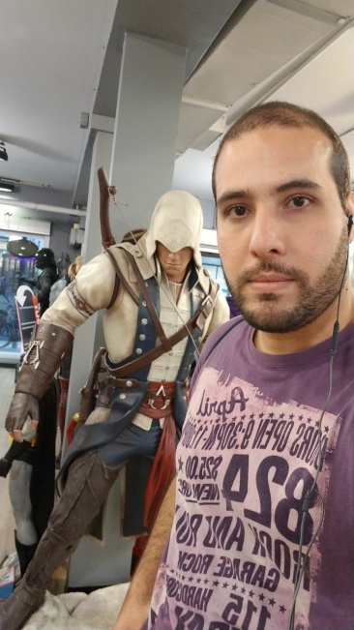



Team Members and Roles
Ranjana Kalra
(Product Manager)
Amit Kumar
(QA Manager)
Julian Giraldo
(Artist / Sound Engineer)
Amarender
(Game Designer)
Arun Bharath
(Lead Software Engineer)
Ronnel
(Software Engineer)

Slide 3
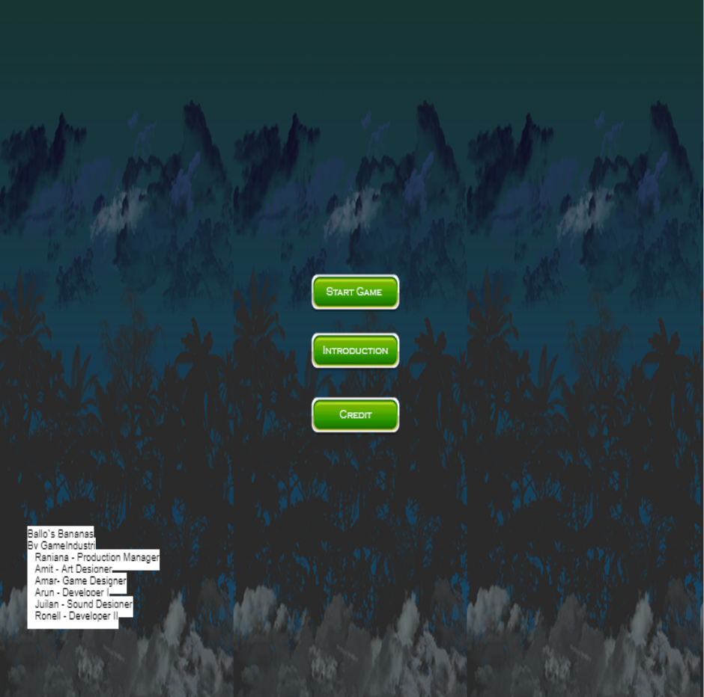
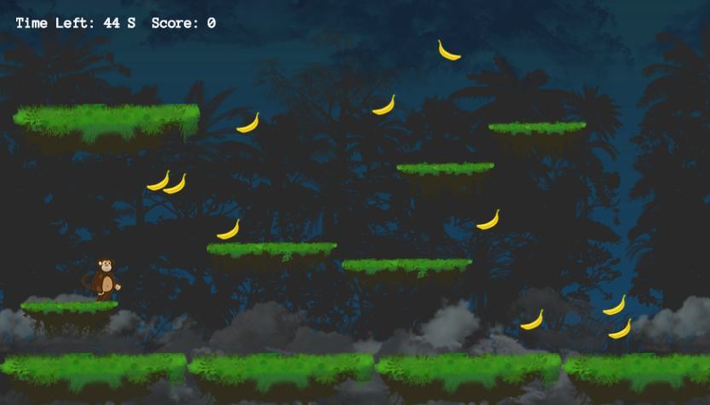
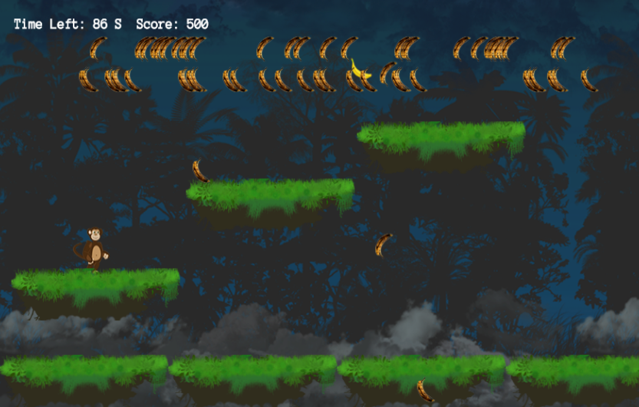
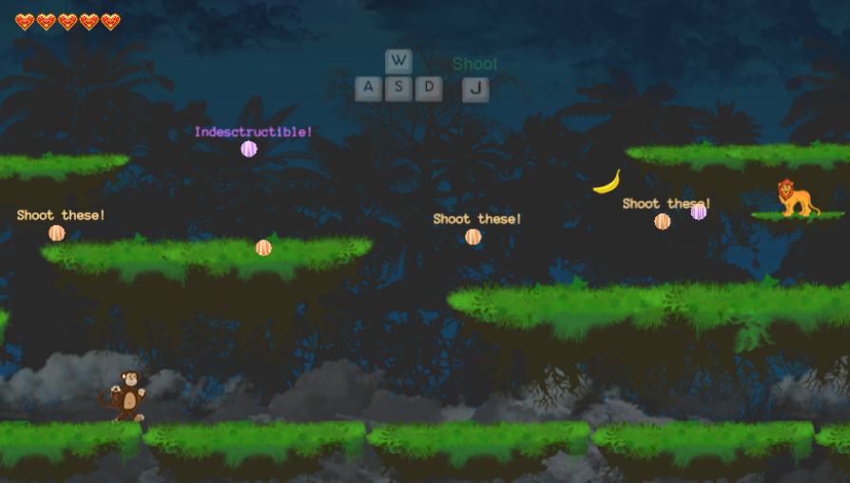
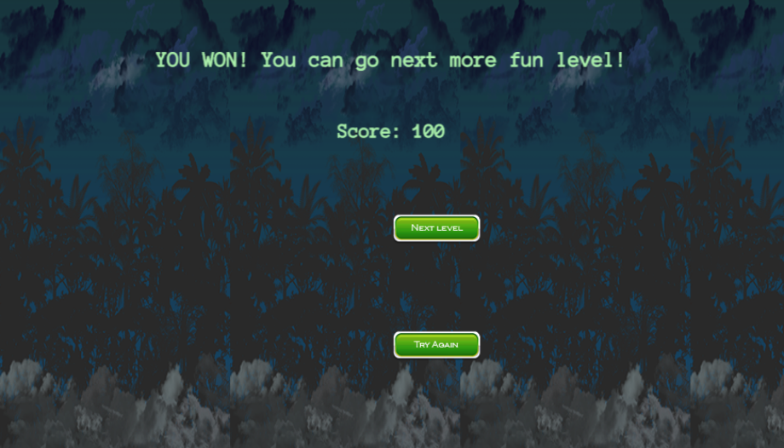
Screenshots

Slide 4
Balloo’s Bananas
This game is a 2D platformer game where the monkey is the player, who has to collect bananas.
More the number of bananas collected, more the points the player earns.

Slide 5
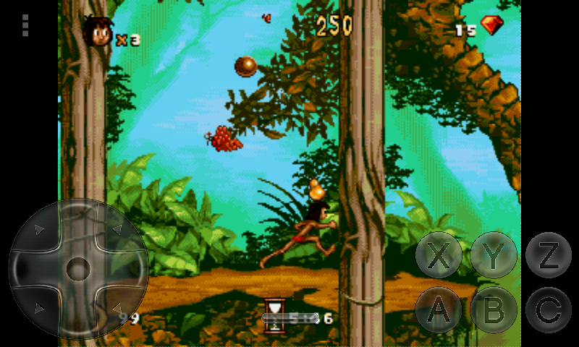
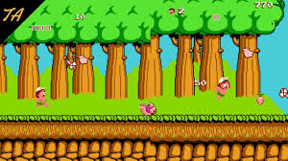
Balloo’s Bananas
Balloo’s banana is a game which is inspired by the Jungle book, Adventure Island and Melvin The Monkey.

Slide 6
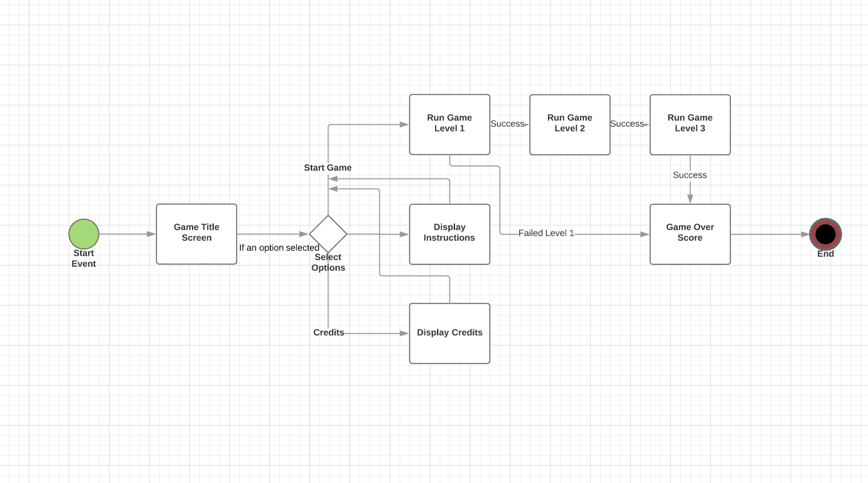
UML Diagram of the Game

Slide 7
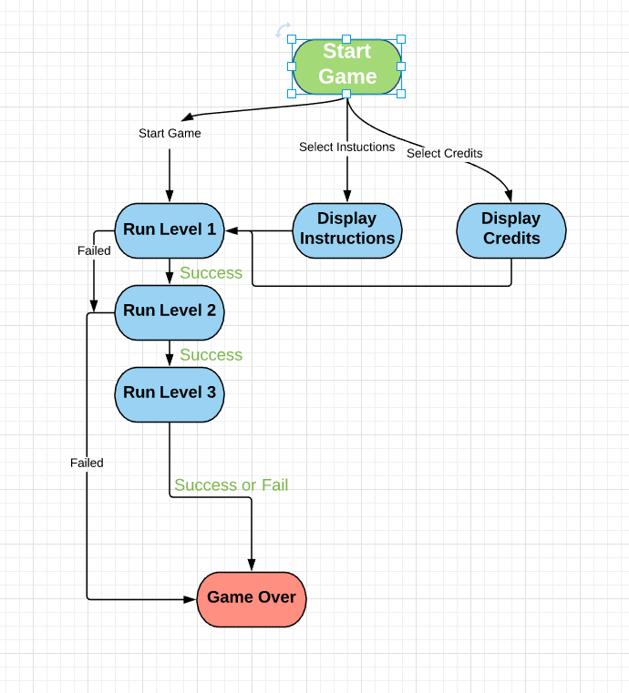
UML Diagram of the Game

Slide 8
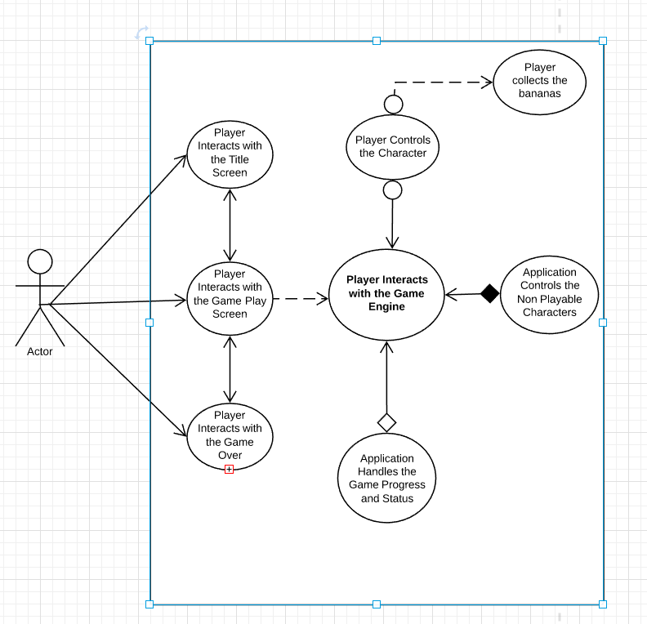
UML Diagram of the Game

Slide 9
Gameplay
The player has to move around the platforms.
Monkey has to collect bananas.
He has to keep the track of number of bananas being collected and the time limit to move to the next level.
To win the game, the monkey has to kill the enemy lion.

Slide 10
Introduction and Concept
This game is developed based on the concept that the player in the game is a monkey.
The game is that the monkey has to collect the bananas in each level to get the score and win the game.
There are 3 different levels of the game with the same base concept but increased level challenges and difficulties.

Slide 11
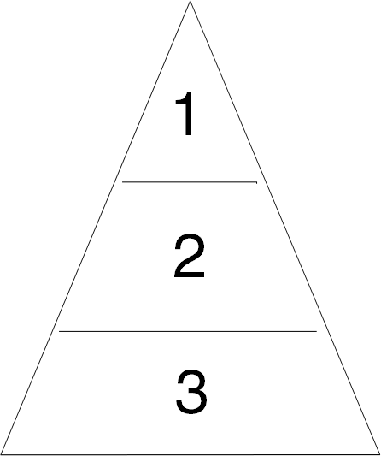
Game Levels
Game has 3 levels
* The Monkey will collect the bananas in given time limit * The Monkey will be chased by enemy monkeys
* Final fight with the Boss

Slide 12
3 Levels
Level 1
In the first level, the player, monkey has to collect bananas within a time limit.
The monkey can jump and move over the platforms to collect the bananas.
Level 2
In the second level, the monkey has to collect the bananas in the time limit.
Also, there are some bananas falling down, which can kill the monkey.
More the bananas collected by the monkey, more is the score achieved by the monkey player.

Slide 13
3 Levels (continued)
Level 3
In the third level of the game, the monkey player has to kill the king of the jungle, which is a lion.
The lion and the monkey would be shooting each other.
The player and the enemy get the power in this level to shoot each other.

Slide 14
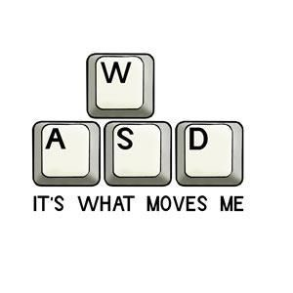
Game Play Mechanics
Mechanics * WASD will be used to move the player and W key to make the monkey jump.
Dynamics * Collect maximum number of bananas.
Challenges * Bananas are to be collected while avoiding enemies within a time limit.

Slide 15
Game Demonstration

Slide 16
Lessons Learnt
First of all, we learned to work in team. It was a challenge to handle the team members and bring them all on one decision.
We learned to be punctual.
Complete our part on time
Time management.
Apart from this, we mainly learnt the typescript.
If we get a chance to build the game again, I think we would divide the work amongst the group members before time and keep a track of progress in regular time intervals. We would also like to improve the concept of the game and increase the difficulty level of the game.

Slide 17
Future Scope
More different levels can be created
A short game with a storyline can be created
The scene can be used in some other game
More Boss battles can be included
More weapons as well as more traps can be included
More varieties of characters or enemies can be implemented
Weapons can be made customizable
We can develop a mobile version of this game for Android, Windows and IOS.

Slide 18
Thank You.

